Slide 1
Introduction to Control Systems

Slide 2
Input
Input
The stimulus or excitation applied to a control system from an external source in order to produce the output is called input
2

Slide 3
Output
Input
Output
The actual response obtained from a system is called output.
3

Slide 4
“System”
SYSTEM
Input
Output
A system is an arrangement of or a combination of different physical components connected or related in such a manner so as to form an entire unit to attain a certain objective.
4

Slide 5
Combining above definitions
System + Control = Control System
It means to regulate, direct or command a system so
that the desired objective can be attained
5

Slide 6
Control System
CONTROL SYSTEM
Input
Output
It is an arrangement of different physical elements connected in such a manner so as to regulate, direct or command itself to achieve a certain objective.
6

Slide 7
Difference between System and Control System
Input
System
Proper
Input
Control System
Desired
Output
Output
(May or may not
be desired)
7

Slide 8
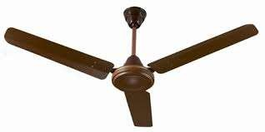
Difference between System and Control System
An example : Fan
230V/50Hz
Fan (System)
Air Flow
Input
Output
AC Supply
8

Slide 9

A Fan: Can't Say System
A Fan without blades cannot be a “SYSTEM” Because it cannot provide a desired/proper output
i.e. airflow
Input Output
230V/50Hz
No Airflow
AC Supply
(No Proper/ Desired Output)
9

Slide 10
A Fan: Can be a System
A Fan with blades but without regulator can be a “SYSTEM” Because it can provide a proper output i.e. airflow
But it cannot be a “Control System” Because it cannot provide desired output i.e. controlled airflow
Input Output
230V/50Hz
Airflow
AC Supply
(Proper Output)
10

Slide 11

A Fan: Can be a Control System
A Fan with blades and with regulator can be a “CONTROL SYSTEM” Because it can provide a Desired output.
i.e. Controlled airflow
Control Element
Input
Output
230V/50Hz
Controlled Airflow
AC Supply
(Desired Output)
11

Slide 12
Classification of Control Systems

Slide 13
Classification of Control System
Classification of Control System
Natural control system
Man Made control system
Manual
automatic
13

Slide 14
Classification of control system
Natural control system: the system inside a human being or biological system
Man-made control system: : control system that are designed and developed by man. Example an automobile, Air craft, AC, washing machine etc,
Manual control: CONTROL ACTION BY the HUMAN, Example driver driving a car, Fan, Light etc
Automatic control: control action is performed by a machine, example are: AC, Servo Voltage stabilizer, Automatic washing machine, etc
Combinational control system: this control system is a combination of natural and manmade

Slide 15
Classification of Control System
Classification of Control System
Analog Control System
Discrete Control System
15

Slide 16

Classification of control system
Continuous Time or Discrete time Control Systems :
If the signals in all parts of a control system are continuous functions of time, the system is continuous time feedback control system.
(e.g. speed control of motor by tacho-generator)
If one or more system variables of a control system are know at a certain discrete time ,the system is discrete time control system
(e.g. computer system)Microprocessor/ Micro control based control System

Slide 17
Classification of Control System
Classification of Control System
Linear Control System
Non-linear Control System
If a system obeys superposition principle the system is said to be a linear system.
If it does not obey superposition principle is said to be a non-linear system.
17

Slide 18
Classification of Control System
Classification of Control System
Time Varying Control System
Time Invarying Control System
Systems whose parameters vary with time are called time varying control systems.
When parameters do not vary with time are called Time Invariant control systems.
18

Slide 19
Cont...
• Lumped and distributed control system
• SISO and MIMO control system
Optimal control
Adaptive control system
• Closed loop and open loop control system

Slide 20
Classification of Control System
Classification of Control System
(Depending on control action)
Manual Control
Open Loop
Closed Loop(speed, position control)
Control System
Automatic Control
Open Loop
Closed Loop(speed, position control)
Control System
20

Slide 21
Classification of Control System
Classification of Control System
(Depending on control action)
Open Loop Control System
Manual
automatic
Closed Loop Control System
Manual
automatic
21

Slide 22
Open Loop Control System
Definition:
“A system in which the control action is totally independent of the output of the system is called as open loop system”
Controlled o/p
c(t)
Reference I/p
 | Controller
Process
r(t)
u(t)
Fig. Block Diagram of Open loop Control System
22

Slide 23
Open Loop Control Systems
A system in which the output has no effect on the control action is known as an open loop control system.
For a given input the system produces a certain output

Slide 24
Open Loop Control System
A Fan with blades and with regulator is a open loop “CONTROL SYSTEM”
Desired Reference
Regulator (controller)
Control Input
Plant(Fan)
Control Element
Input
Output
230V/50Hz
Controlled Airflow
AC Supply
(Desired Output)
24

Slide 25
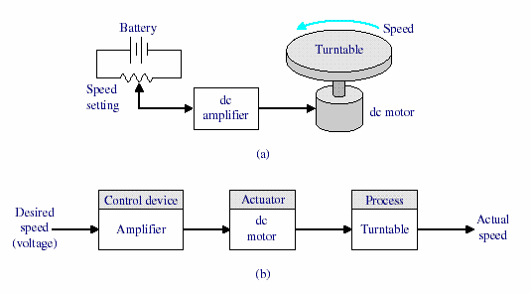
Open Loop control System

